Slide 1


MECHAURA 2022 design dexterity challenge
The Armrest battle
© 2022 Collins Aerospace. | Collins Aerospace Proprietary. | This document does not include any export controlled technical data.

Slide 2

THE ARMREST BATTLE
PREMISE:
Hostile elbow exchanges with fellow fliers are frequently listed as among the biggest annoyances of being crammed into an aircraft with other humans. This causes unpleasant flying experience and discomfort to passengers, especially in the economy seating.
Highly effects middle seat passengers, as compared to the rest. Physiologically different people may need more, or less space and can hence, cause conflicts.
This poses an opportunity to innovate and solve this problem.

Slide 3
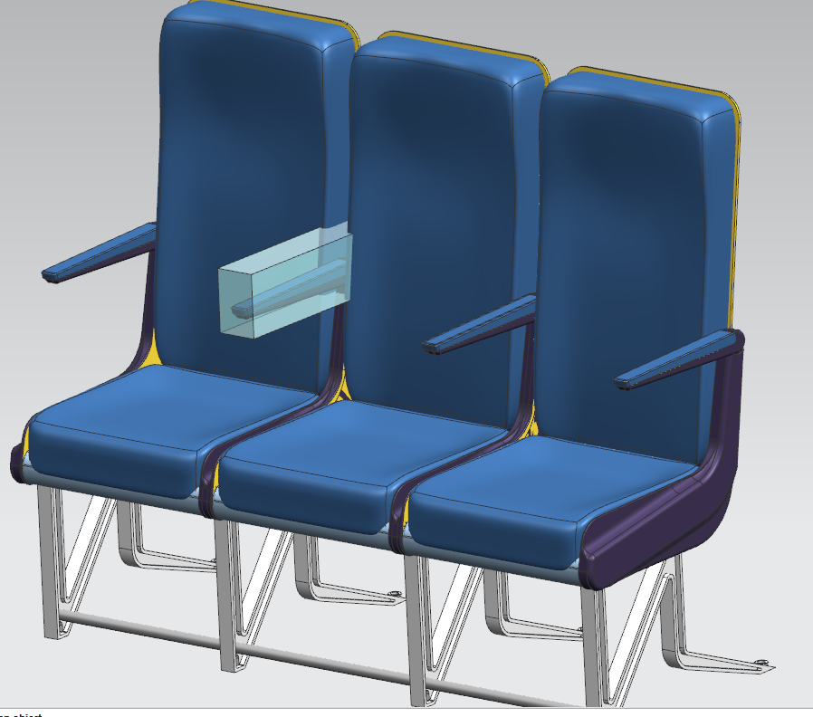
Problem statement
Objective:
Ideate and propose a solution that helps passengers to rest their arms comfortably thereby improving passenger experience.
The design should be a “retrofit design’ which seamlessly integrates with the given armrest design. (Attached Seat Model in .STEP format).
The design should withstand a load of 120lbs, and subjected to inertial loads of 2.0Gs applied vertically down, and 0.5Gs applied in lateral direction.
The design should have a factor of safety of 2.5.
The design should be fit within the given volume (body) specified in the attached model.
Output:
A successful submission will include a CAD model (Step format) of the design with a PowerPoint presentation explaining in brief about the design, approach, FBD, Bill of material, manufacturing process, analysis report.
The PowerPoint slides shouldn't exceed 7 slides.
(For your reference, an example of a solution is: https://www.soarigami.com/ )
Design should not exceed the given bounding box

Slide 4
Evaluation criteria
 | INSTRUCTIONS | WEIGHTAGE
DESIGN | Novelty: Explain your understanding of the problem and the solution model proposed, based on the literature survey done. Innovative and original ideas are encouraged. The concept is to be explained with clarity. | 25%
 | Design: Demonstrate the design durability by explaining boundary conditions, FBD, mathematical models, material selection, manufacturing process proposed, and other parameters that might be considered. | 30%
CAD | Substantiate your design proposal by creating a CAD model that fits over the given Seat CAD (attached in this email). The solution is to be submitted in a .STP file. | 25%
ANALYSIS | FE Analysis using any standard FE package: The analysis should provide preliminary analysis considering aircraft boundary conditions (to be mentioned) and contribute to the proposed solution. | 10%
ADVANCED | Demonstrate the use of any advanced tools for optimization of design or application of AI/ML models for establishing the design. | 10%

Slide 5
SOLUTION PROPOSED

Slide 6
DESIGN DETAILS

Slide 7
fbd / mechanism

Slide 8
Material and manufacturing process
Material proposed: Thermoplastic Polyurethane
Material Property | Value
Density | 1.28 - 1.66
Young’s Modulus | 0.621 – 5.50 GPa
Poisson’s Ratio | 0.3897
Hardness (R) | 60 - 70

Slide 9
analysis

Slide 10
miscellaneous

Slide 11
conclusion

